Slide 1
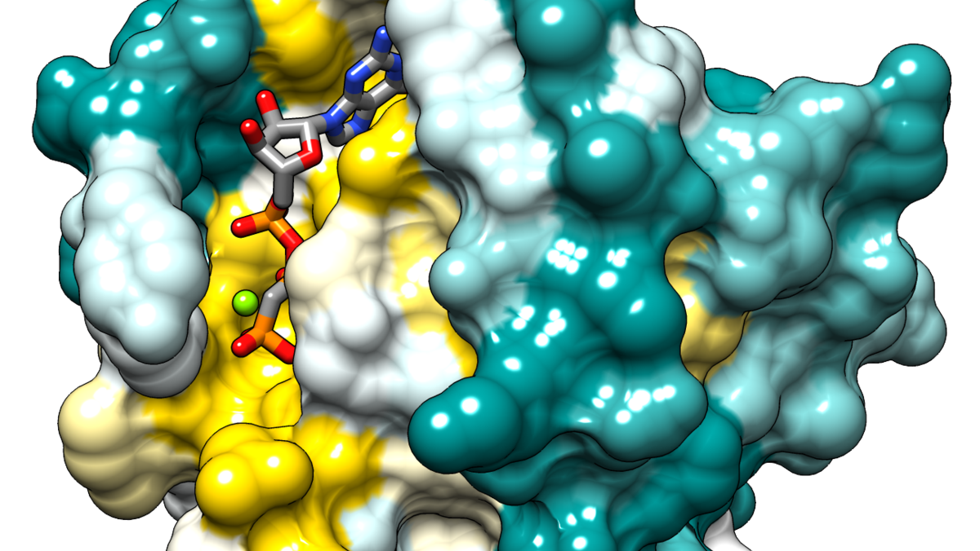
POCKET P.
SIMULATING MOLECULAR DYNAMICS OF POTENTIAL DRUG TARGET REGIONS
MIKE TRENFIELD MILO LIN JOHN YOO UMBERTO CIRI KEVIN NGUYEN

Slide 2
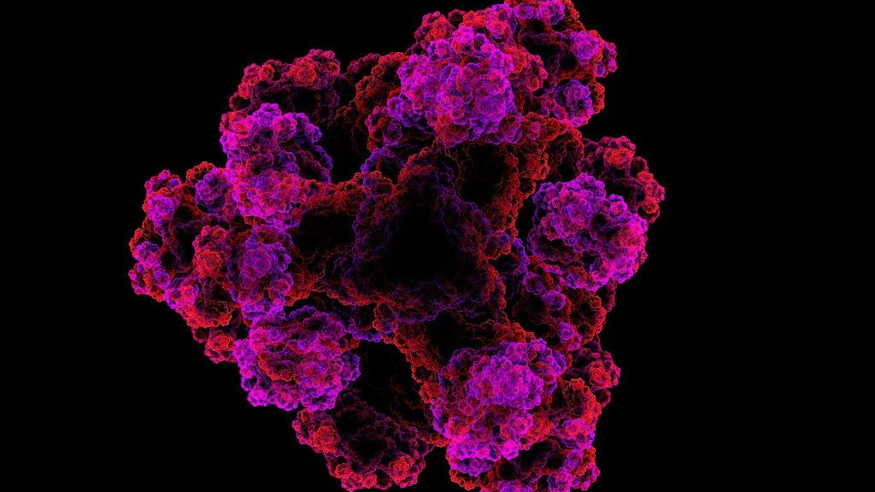
DEFINING THE PROBLEM GOAL
RAS FAMILY OF G-PROTEINS
UNDRUGGABLE
LACK OF BINDING POCKETS
UNEXPLORED DYNAMIC STRUCTURE
IDENTIFY THE SHAPE & LOCATION OF TRANSIENT POCKETS

Slide 3
SCOPE
DATA ANALYSIS
LOCATE POCKET
FIND VOLUME OF POCKET
TRACK POCKET STABILITY OVER TIME
VISUALIZATION
3D IMAGE OF EACH FRAME
REAL TIME VIDEO MODUEL

Slide 4
VISUALIZATION 20 microsecond long simulation

Slide 5
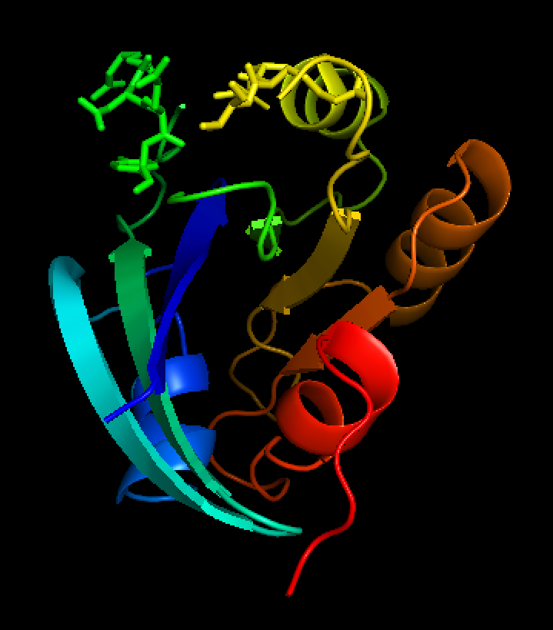
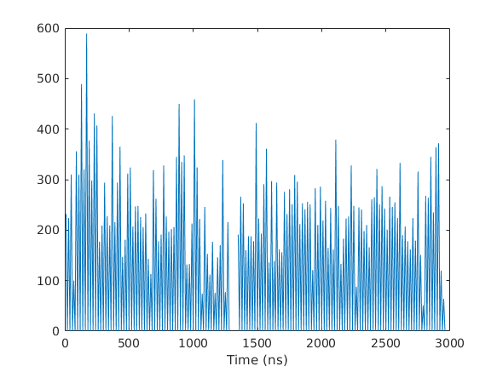
DATA ANALYSIS EXAMPLE OF DISCOVERED POCKET
POCKET VOLUME OVER TIME
PYMOL RENDERING OF POCKET

